Slide 1
An introduction to machine Learning
Spring 2019
Course prerequisites, syllabus, and objectives

Slide 2
Prerequisites
We do not use any advanced mathematics in this course. If you’ve taken the SAT or the GRE you’ve already come across math that is much more advanced than anything you will need for this course.
Alternatively, if you’re comfortable working with spreadsheets (nothing fancy, just basic formulas and manipulations like sorting rows), you will be comfortable with all of the mathematics used in this course.
Hands-on learning is encouraged using the Orange data science platform (https://orange.biolab.si/) – a visual way to solve machine learning problems without programming.
For those with some programming knowledge of Python, we provide Jupyter notebooks that can be used to build, run, and experiment with machine learning models.
NOTE: Python knowledge is NOT a prerequisite for the course. The course assignments (homework, group presentation, and the final exam) do NOT require any Python programming.

Slide 3
What We’ll Cover in the Course
Part 1: The Mechanics of Prediction. In Part 1 we’ll dive right into machine learning, unpacking the key concepts. We’ll apply these concepts to make predictions from real datasets. We’ll cover the basic techniques of machine learning – regression and logistic regression – and get a feel for the practical things that data scientists do. We’ll round out this part by taking a look at more advanced machine learning techniques.
Part 2: The Science of Machine Learning. In Part 2 we’ll learn to systematically evaluate the performance of machine learning models. We’ll understand how to define performance and measure it. We’ll use this knowledge to not only build the right machine learning models but build them right.
Part 3: The Art of Machine Learning. In Part 3 we’ll tackle the art of machine learning – how to get the most predictive bang for our data buck. In other words, we’ll learn about how to make the most out of the data we have.
Part 4: Select Topics in Machine Learning. Finally, in Part 4 we’ll cover select topics in machine learning: segmenting customers, spotting fraud, detecting spam, and building a machine learning system.

Slide 4
Outline of topics
Part 1: The Mechanics of Prediction
Introduction to machine learning
What makes machine learning possible?
What's different about machine learning?
How does it work?
The types of machine learning
Problems that are particularly suitable for machine learning and ones that are not (at least not yet)
The business value of machine learning
Predicting a numerical value: Regression
Linear regression (using single and multiple features)
Non-linear regression (using single and multiple features)
Measuring the performance of regression models
Training and Test data sets
Performance measures
Predicting a categorical value – part 1
Logistic regression (using single and multiple features)
Non-linear logistic regression (using single and multiple features)
Predicting a categorical value – part 2
Support Vector Machines
Neural Networks
Decision Trees
Random Forests
Measuring the performance of logistic regression models. Precision, recall, and accuracy.
Part 2: The Science of Machine Learning
Preparing data for prediction
Data pre-processing and cleaning
Systematic visualization of data sets
Systematic investigation of data sets
An overview of models
The menu of different machine learning models, why we need them, and when to use them. (The problem of having enough data; the no-free-lunch theorem.)
Overfitting and underfitting; what they are and how to handle them.
Comparing rule-based, statistical, and machine learning-based approaches to prediction.
Finding the optimal hyper-parameters of a model
Models, parameters, hyper-parameters
Training, validation, and test datasets
Model complexity
Tuning a model's hyper-parameters (including k-fold cross validation)
Measuring and improving model performance
Precision, recall and other measures of prediction capability (again)
Bias and variance
Learning curves to determine model bias and variance
Techniques for improving model performance

Slide 5
Outline of topics (contd.)
Part 3: The Art of Machine Learning
Feature selection – tree based, sequential selection, and dimensionality reduction.
Feature engineering – combining features, manufacturing features.
Part 4: Select Topics in Machine Learning
Unsupervised models -- similarity and clustering.
The surprising power of ensemble models
Building a spam filter using a Naïve Bayes model
Learning from images and text
The promise of deep learning

Slide 6
What is not covered in this course
We will not cover the details of machine learning algorithms – how they are designed or how to make them efficient.
We will not cover the theoretical underpinnings of machine learning – probability, statistics, statistical inference, numerical computation, etc..
We will not cover computer science topics such as data structures, algorithm design, search, etc..
We will not cover deep learning and associated platforms like TensorFlow, Keras, PyTorch, Theano, etc.
We will not cover data architecture/engineering for implementing machine learning systems at scale.
This is not a course for students seeking to learn the theoretical and mathematical underpinnings of machine learning.

Slide 7
By the end of this course you’ll be able to…
List the types of problems that can be solved using machine learning.
Understand the seven key steps to solving any machine learning problem.
Apply machine learning techniques such as regression and classification to solve a variety of business problems using real-world data.
Build strong intuitions about machine learning techniques by implementing them in a hands-on interactive programming environment.
Systematically investigate and improve the results produced by machine learning models.
Collaborate productively with your data science team.
Keep up with the rapidly progressing field of machine learning and AI.

Slide 8
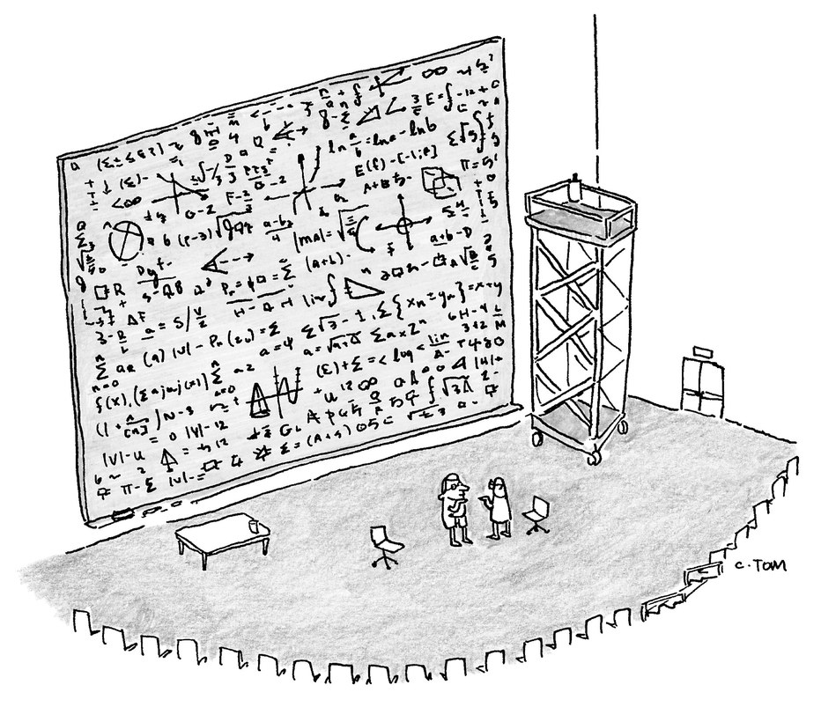
“The math is right. It’s just in poor taste.”
New Yorker, August 28, 2015

Slide 9

The Important questions
How do you take available data and translate it into a business problem you can solve?
How do you know your machine learning system is not learning too little or too much?
What’s the right measure of a machine learning system’s performance?
Understanding the business context is a critical component of success in building machine learning systems.
Notes:
What data do you use?
How do you get data into the right “machine learning” format?
How do you know you’re not learning too much or too little?
How do you measure the performance of your learning system?
Instead of our old fashioned data analysis, here’s what we do instead.
A systematic way to answer the question of system performance is to use the concepts of BIAS and VARIANCE.
So what are bias and variance? Only the two most important concepts ever in machine learning!
But first, a look at the data.

Slide 10
The Orange machine learning platform
https://orange.biolab.si/

Slide 11
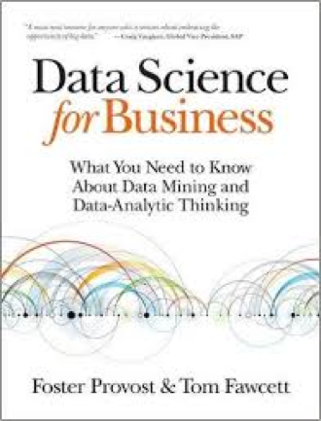
Other useful sources
Nice alternative view – useful when you’re learning something new.
Strong on the business aspects of data science – chapters 1, 2, 11, 13, and 14.
Additional book suggestions:
DataSmart by John Foreman
AIQ by Nick Polson and James Scott
The Master Algorithm by Pedro Domingos
Lots of useful blogs/websites:
Adam Geitgey (Machine Learning is Fun)
Jason Brownlee (Machine Learning Mastery)
Sonya Swatelle (Evening Session)

